Slide 1
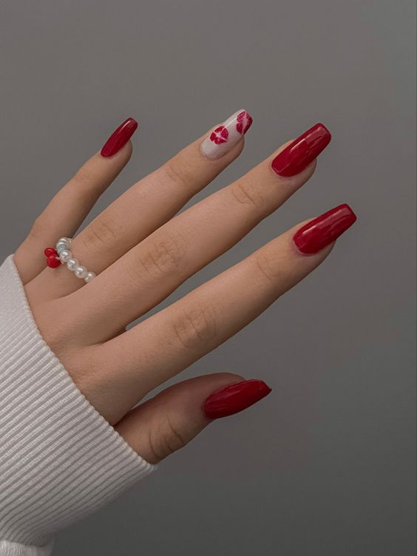

Nail Art Salon
BY ANUSHKA TRIPATHI

Slide 2






ANUSHKA TRIPATHI NAIL TECHNICIAN
123-456-789 | bookme@gmail.com
Happy Fingers Nail Salon
Near Sector 10 , Kalyanpur Street
Kanpur, Uttar Pradesh
@happyfingersocialhandle
www.happyfingers.com

